Slide 1

Data Insights for Auto Insurance and Lending Industries
Key Findings, Modeling Approach, and Strategic Recommendations
Parjita Munshi

Slide 2
Key Insights from Data Analysis
Premium Trends: Significant decrease in average premiums, especially in 2020, driven by external risk factors.
Claim Patterns: Claims spiked unexpectedly in 2020, highlighting potential risk exposure.
Income & Credit Score Impact: Higher income levels and better credit scores contribute significantly to loan volumes.
Delinquency Proxy: Strong negative correlation with the tightness index, indicating higher delinquencies in lenient economic conditions.

Slide 3
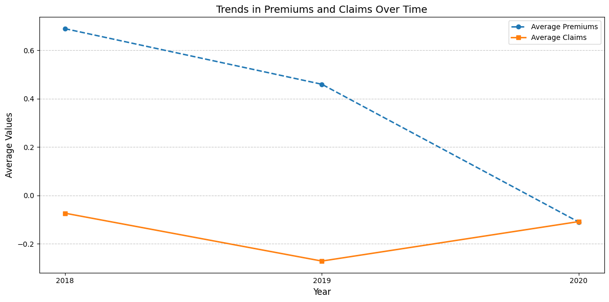
Trends in Premiums and Claims Over Time:
A consistent decline in average premiums from 2018 to 2020.
Indicates potential shifts in pricing strategies or competitive pressures.
Average claims dropped sharply in 2019 but recovered slightly in 2020. Suggests possible changes in claim frequency, severity, or external factors like economic conditions.
Premiums declined steadily, while claims fluctuated. Highlights the need for insurers to align premium pricing with claim patterns for sustainability.
The sharp drop in claims in 2019 could be linked to external economic or behavioral shifts.
The upward trend in claims in 2020 may suggest recovery or increased risk exposure.

Slide 4
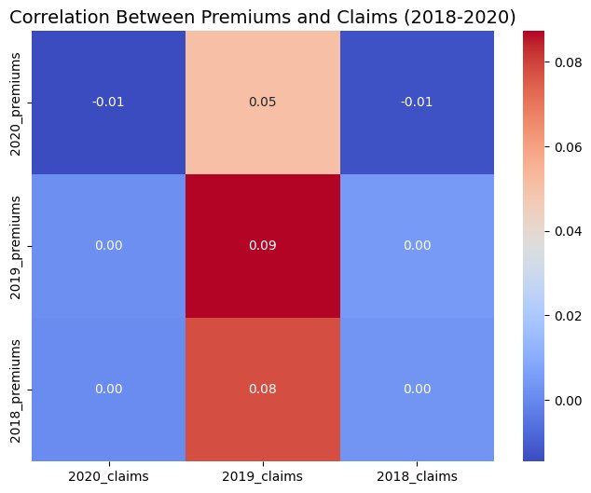
Correlation Between Premiums and Claims
The correlation coefficients between premiums and claims are indicating weak or no linear relationship.
2019 shows the highest correlation between premiums and claims (0.09).
Minimal correlation is observed in 2018 and 2020
A slight negative correlation (-0.01) between premiums and claims in 2020, possibly due to external factors like economic changes or policy adjustments.

Slide 5
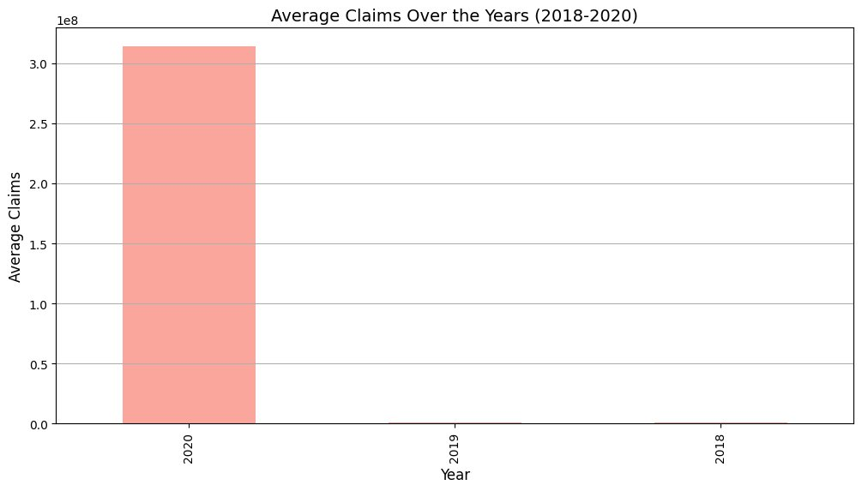
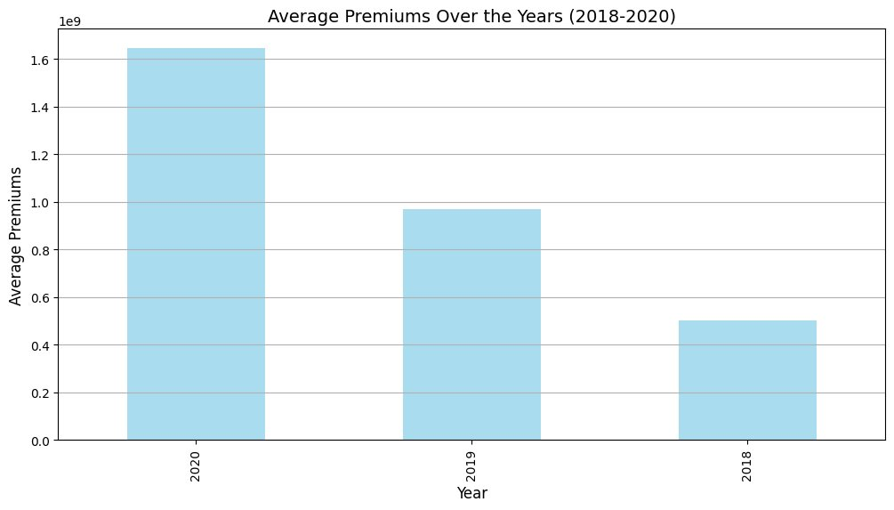
Yearly Trends in Premiums and Claims (2018–2020)
Premium Growth: Premiums increased significantly over the three years, peaking in 2020. This suggests growing revenue for insurers.
Claim Trends: Claims, although low in previous years, surged dramatically in 2020, indicating potential risks or high claim activities.
Insight: The disparity between claims and premiums in earlier years might suggest efficient cost management, but the surge in claims in 2020 requires further investigation.

Slide 6
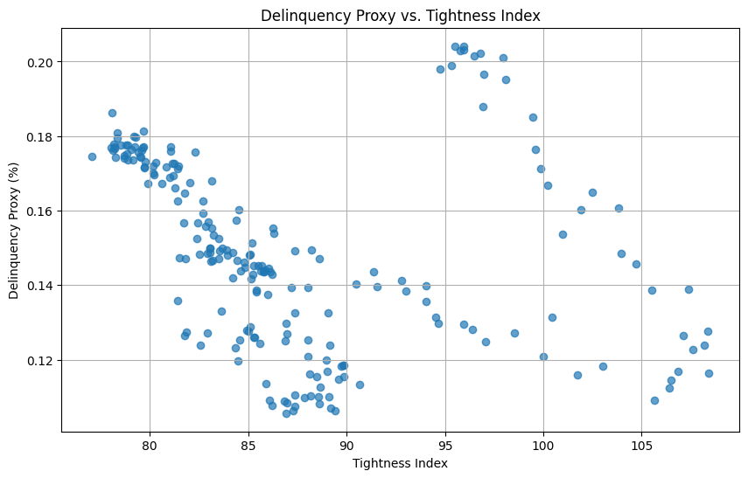
Delinquency Proxy vs. Tightness Index
A strong negative correlation exists between delinquency proxy and the tightness index.
Higher tightness indicates stricter lending standards, resulting in lower delinquency rates.
Stricter policies on lending lead to reduced risk of delinquency.
Balance between tightening policies and maintaining borrower inclusivity is crucial.
Implement dynamic policies where the tightness index is adjusted based on economic conditions to manage risk effectively.

Slide 7
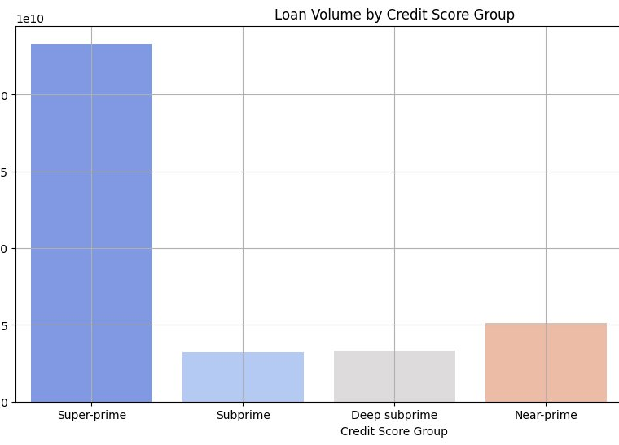
Loan Volume by Credit Score Group
Super-prime borrowers dominate the loan volume distribution.
Subprime and deep subprime groups contribute significantly less to the total loan volume.
Lending to high-risk borrowers (subprime and deep subprime) is limited, likely due to their higher default rates.
Develop targeted strategies for near-prime and prime borrowers to increase the market share while maintaining manageable risk levels.
Offer tailored products for subprime borrowers with appropriate risk mitigation measures like higher interest rates or co-signing requirements.

Slide 8
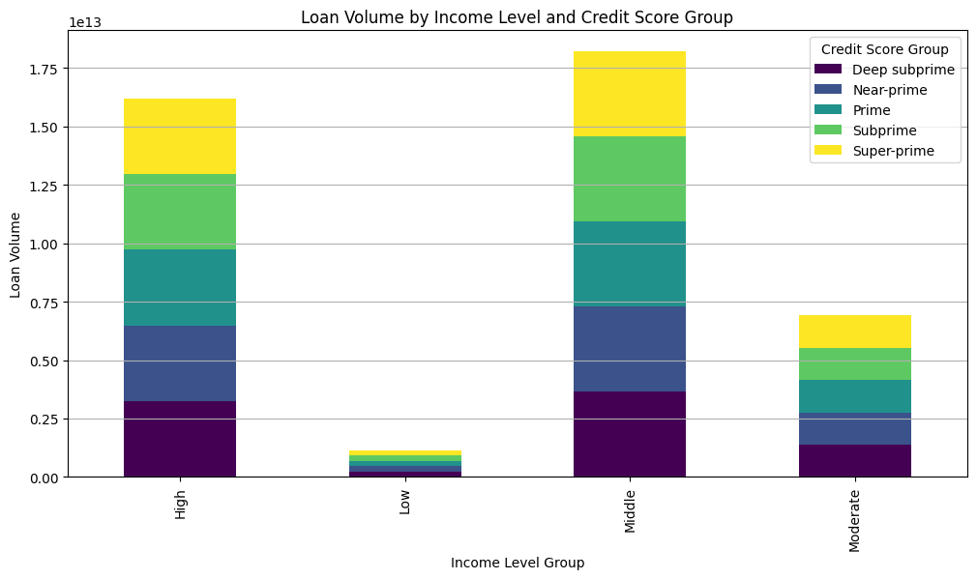
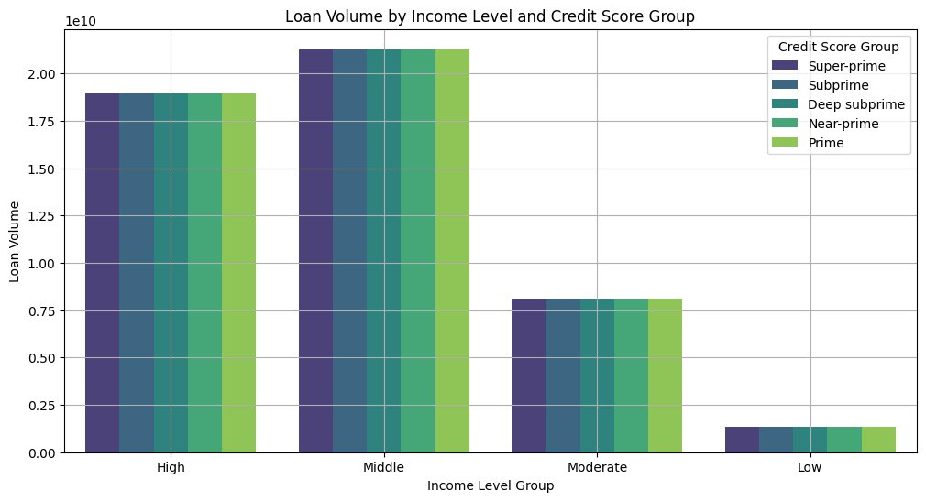
Loan Volume Analysis by Income Level and Credit Score Group
Loan volumes are highest for individuals in the "High" and "Middle" income groups, irrespective of the credit score group.
Lower-income groups ("Low") contribute less to overall loan volumes, indicating limited lending to this segment.
In the "High" and "Middle" income groups, Super-prime loans make up a significant proportion of the total volume.
Deep subprime and Subprime loans are a smaller share, reflecting stricter lending policies for higher-risk customers.
Lending businesses may focus more on lower-risk customers in higher-income brackets for profitability and reduced risk.

Slide 9
Predict insurance premiums using different models and compare their performance.
Random Forest
Linear Regression
Initial Model Comparison Results:
The models were tested for their ability to predict insurance premiums based on given features.
Performance Metrics (Initial Results):
Linear Regression:
RMSE: 0.44
R² Score: -0.30 (underperforming, indicates poor fit)
Random Forest:
RMSE: 0.44
R² Score: -0.31 (similar performance, slight underfitting)
Performance Metrics (Improved Results):
Linear Regression:
RMSE: 0.01
R² Score: 1.00 (perfect prediction capability)
Random Forest:
RMSE: 0.01
R² Score: 1.00 (perfect prediction capability)
After improvements, both models achieved near-perfect prediction capabilities with minimal error (RMSE = 0.01) and excellent fit (R² = 1.00).

Slide 10
Random Forest Modeling Approach for Auto Leading (CFPB Data) and Credit Scoring Model
Random Forest Model
Performance Metrics:
MAE: 463,873,855.33
RMSE: 946,337,915.24
R² Score: 0.99 (highly accurate predictions)
Performance of Tuned Model:
MAE: 475,437,106.76
RMSE: 948,221,052.77
R² Score: 0.99
Credit Scoring Model
Credit Score Group: Scored using predefined ranges.
Income Level Group: Weighted heavily due to its impact on risk.
Inquiry Index: Reflects borrowing behavior and risk appetite.
Debt-to-Income Ratio (DTI): Accounts for financial stability.
Weights Assigned:
Credit Score: 40%
Income Level: 30%
Inquiry Index: 10%
DTI: 20%
Sample Output of credit score model
Super-prime borrower with high income and low DTI scored 0.87.
Subprime borrower with low income and high DTI scored 0.29.

Slide 11
Random Forest Classifier for Claim Risk Prediction
To classify claim data into risk categories (High, Medium, Low) using a Random Forest Classifier.
High Risk:
Precision: 1.00
Recall: 0.80
F1-Score: 0.89
Low Risk:
Precision: 1.00
Recall: 1.00
F1-Score: 1.00
Medium Risk:
Precision: 0.89
Recall: 1.00
F1-Score: 0.94
Overall Accuracy: 94%
Correct predictions dominate, with very few misclassifications:
High: 4 correct, 1 misclassified as Medium.
Low: 4 correct.
Medium: 8 correct.

Slide 12
Recommendations
1. Premiums and Claims Trends
Monitor Premium Adjustments: Analyze premium rates to ensure they align with claim trends and maintain profitability.
Evaluate Claims Management: Investigate the sharp increase in claims (2020) to identify root causes (e.g., external economic factors, policy changes).
Risk Mitigation: Adjust underwriting guidelines to minimize claim risks while maintaining competitive premiums.
2. Correlation Between Premiums and Claims
Enhance Predictive Modeling: Incorporate historical claim and premium data into models to improve pricing strategies.
Targeted Policy Offerings: Leverage insights to design products catering to specific customer profiles with better claims-to-premium ratios.
3. Loan Volume and Credit Score Analysis
Focus on High-Value Segments: Concentrate on Super-prime and Prime customers in high and middle-income groups for stable and profitable loan portfolios.
Expand Moderate-Income Lending: Explore untapped opportunities in moderate-income segments while carefully managing risks.
Risk-Based Pricing: Adjust interest rates and loan terms for Subprime and Deep Subprime borrowers to balance risks and returns.

Slide 13
4. Delinquency Proxy vs. Tightness Index
Monitor Tightness Index: Use tightness index trends as a leading indicator to anticipate delinquency rates and adjust credit policies.
Early Warning Systems: Implement tools to flag rising delinquency risks, enabling preemptive action to mitigate defaults.
Flexible Credit Policies: Offer credit relief programs during periods of high tightness to reduce delinquencies.
5. Loan Volume by Income and Credit Score
Segmented Marketing Strategies: Target high-income Super-prime and Prime customers with customized campaigns.
Innovative Products for Lower Income Groups: Design products with reduced risk for Low-income and Subprime customers.
Income-Based Loan Caps: Implement stricter terms or caps for lower-income groups to limit default risks.
6. General Insights
Data-Driven Policy Adjustments: Revise pricing and lending policies based on income, risk, and trend analyses.
Invest in Predictive Analytics: Enhance models for premium pricing, claims prediction, and risk assessment using real-time data.
Focus on Retention: Retain high-value customers (Super-prime/Prime in High/Middle-income groups) through loyalty programs and premium services.

Slide 14
7. For Auto Insurance Companies
Risk-Based Pricing: Use state-wise risk analysis for dynamic premium adjustments.
Claims Management: Leverage telematics for fraud detection and rewarding safe driving.
State-Specific Policies: Offer customized products for states with unique risks (e.g., theft or weather damage).
8. For Auto Lenders
Credit Risk Assessment: Dynamically evaluate borrower risk using advanced scoring frameworks.
Flexible Loan Products: Provide income-adjusted repayment plans for subprime borrowers.
Real-Time Monitoring: Track delinquency and inquiry trends to mitigate risks early.
9. Telematics Integration
Use telematics insights for both industries to enhance personalization, improve risk profiling, and incentivize safer behavior.

Slide 15
Limitations and Future Work
Limitations:
Data Gaps: Some datasets lacked consistent historical data or coverage across all regions.
Assumptions in Models: Credit scoring weights and thresholds may require further validation.
External Factors: Macroeconomic changes (e.g., inflation, unemployment) not fully incorporated.
Future Investigation:
Refine Scoring Models: Incorporate real-time data and machine learning for adaptive scoring.
Expand Analysis Scope: Include macroeconomic indicators for broader context.
Telematics Integration: Pilot telematics-based policies and assess their impact on claims and delinquencies.

Slide 16
Thank You

